Slide 1
Virtual DNS
Olafur Gudmundsson - Engineering
Elenitsa Staykova - Marketing

Slide 2
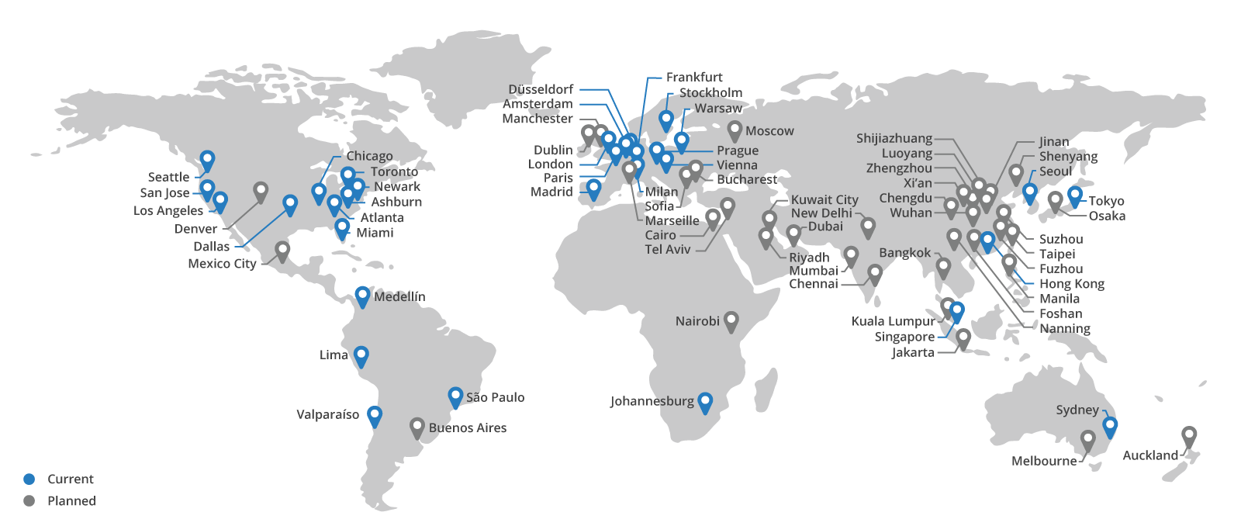
CloudFlare runs a global Anycast network 31 data centers, 2 Tbps of capacity, and constantly expanding

Slide 3
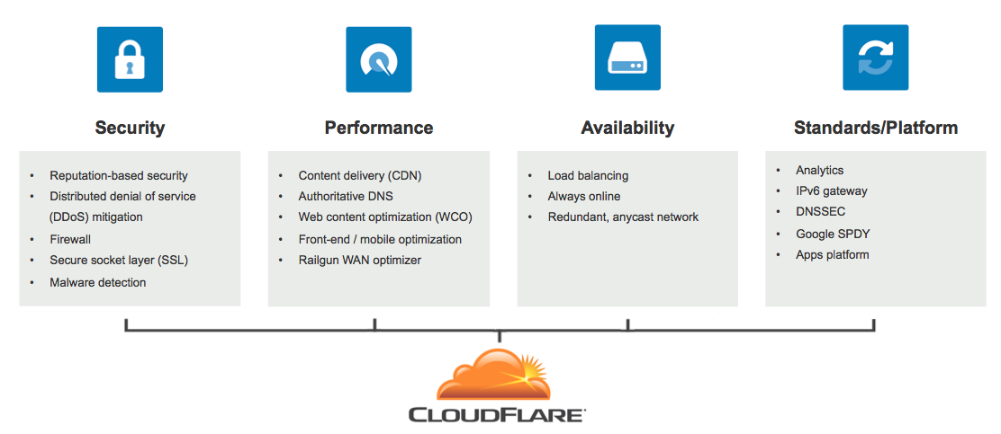
We help you address the challenges of the internet

Slide 4
Outline
What is Virtual DNS?
How does it work?
Why should I use it?
How do I get it?

Slide 5
What is Virtual DNS?

Slide 6
Regular authoritative DNS
Your name servers are used by everyone on the internet
Global distribution is limited
Your staff needs to protect and care for servers
If your servers share links with other services, DoS attacks can bring your whole site down

Slide 7
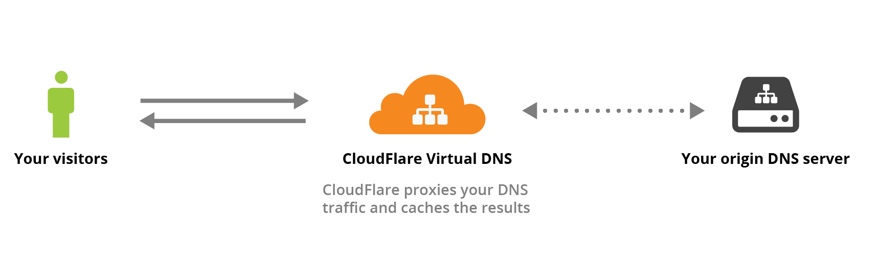
Virtual DNS service
CloudFlare DNS servers are advertised on the network => we get all traffic including DoS
CloudFlare servers fetch your DNS data from “hidden” addresses and reuse it
Instant geographical distribution and IPv6 without any effort from your staff

Slide 8
How does it work?

Slide 9
DNS answers terminology
Not all DNS answers are as as popular as others
Hot: Many queries per second
Warm: Few queries per minute
Cold: Fewer queries
Geographical consumption of answers
Global: from all corners of the world
Continental: clustered in a part of the world
Local: only one country or small part of a country like a city

Slide 10
Part 1: Data consistency
CloudFlare does not move all of your data to the edges. We only cache what is requested in each location. This means less data is moved out from your servers.
CloudFlare DNS is the fastest in the world. Hot data is answered really fast, and warm data (on average) is served faster than your servers can answer.

Slide 11
Part 2: Dynamic changes
Do I need to update CloudFlare if I make changes?
Only when you add/remove/change addresses of your servers. We learn all other changes on the fly.
If my servers go down, what happens?
Virtual DNS will try to fetch data from your servers, but if none of your servers are available, it will lock-down the data it has in cache until servers become available again.

Slide 12
Part 3: How much traffic reaches my servers?
CloudFlare server will fetch data once every 30 seconds from your servers.
Thus the ‘warmth’ of your data is important
Hot data: CloudFlare will serve most of the queries from cache.
Warm data: CloudFlare will frequently serve from cache.
Cold data: Most queries will be sent to your servers.

Slide 13
Why should I use it?

Slide 14
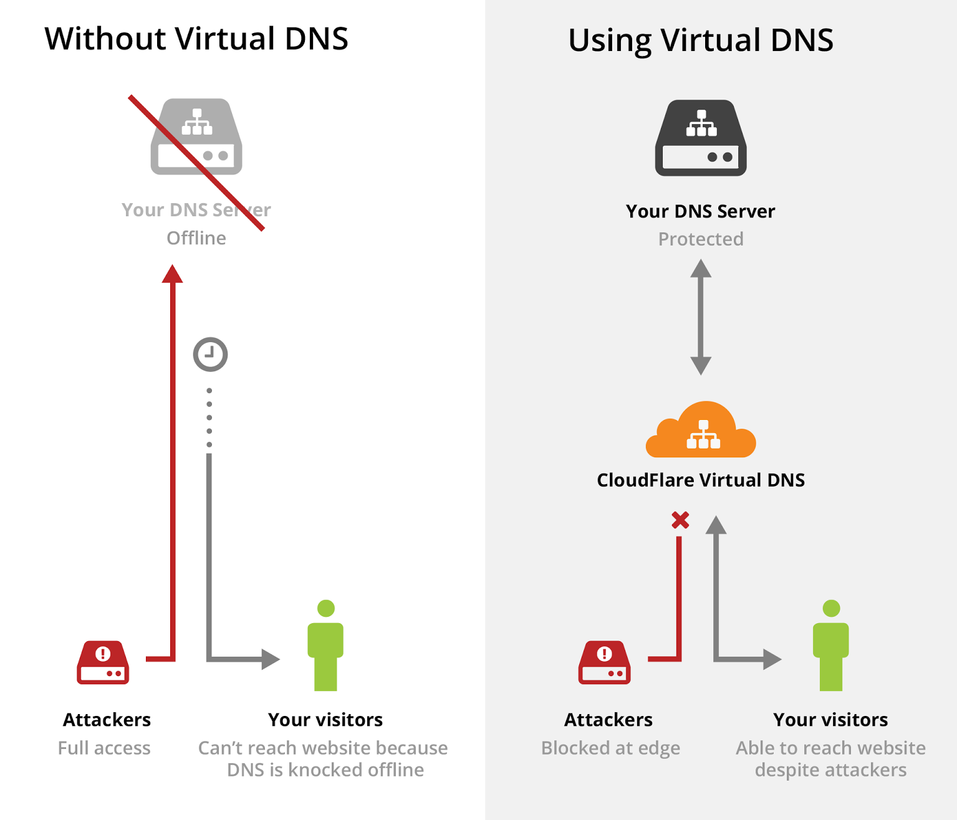
DNS attacks
We absorb attacks and prevent attack traffic from hitting your servers. CloudFlare mitigates 8 billion threats per day
Our many data centers help absorb attacks and distribute traffic evenly, keeping your site fast during an attack.

Slide 15
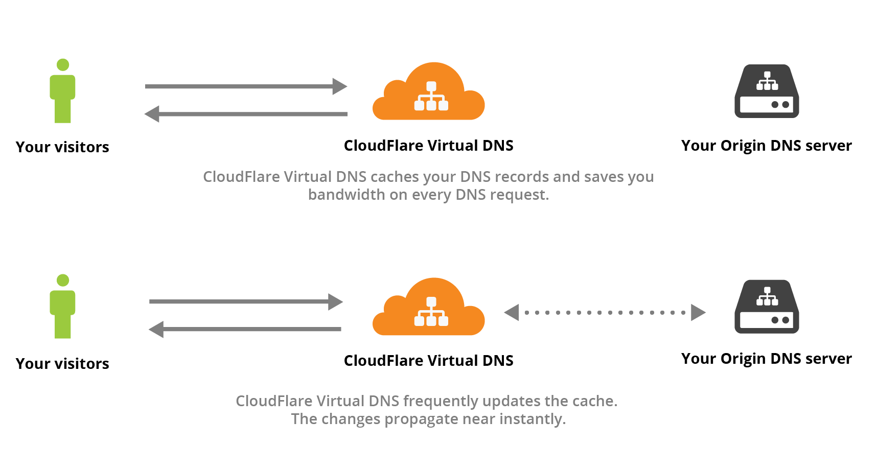
Cost savings
You do not need to:
Build out your infrastructure to handle the worst case. We smooth the spikes.
Operate geographically distributed data centers on anycast or deployments
Worry about where to place DNS zones, our systems “learn” on the fly where data is needed.
You pay less for bandwidth

Slide 16
Planned Extensions
More statistics: We will be adding more API’s and reports so that you can see what is being asked for and from where.
Better caching: We want to “shorten” the distance from your servers to the edges.
More tuning: i.e. how long we cache data, what traffic we are forwarding.
DNSSEC: We support DNSSEC signed zones. We plan to add the ability to sign your zones on the fly like we do for the zones we host.

Slide 17
Questions

